Slide 1
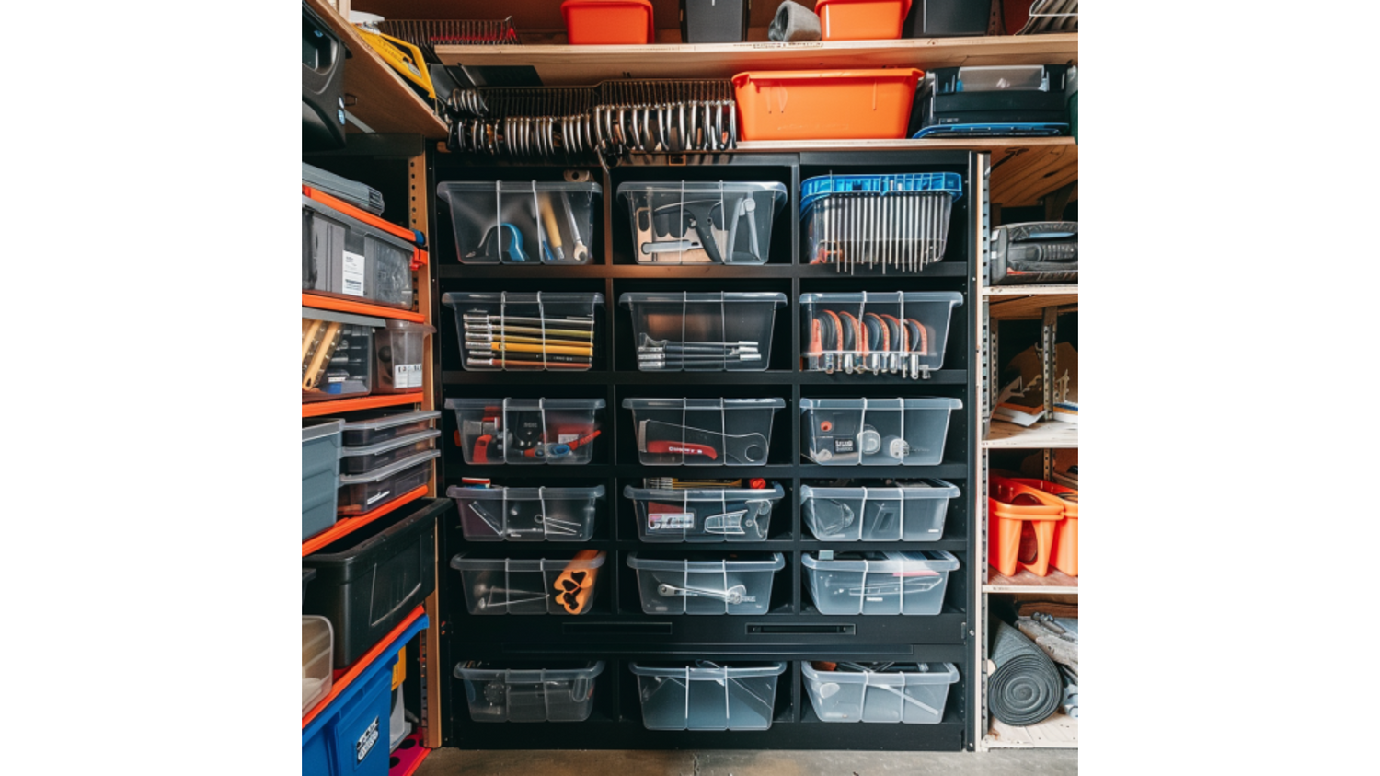
A Decade of Innovation: Collaborating with a Leading EU Manufacturer in Garden and Power Tools
For over a decade, Flair Plastic Ltd. has partnered with a leading European manufacturer in the garden and power tools industry. This collaboration has been pivotal in producing high-quality plastic components that contribute to the success of a wide range of tools, driving mutual growth and innovation.

Slide 2
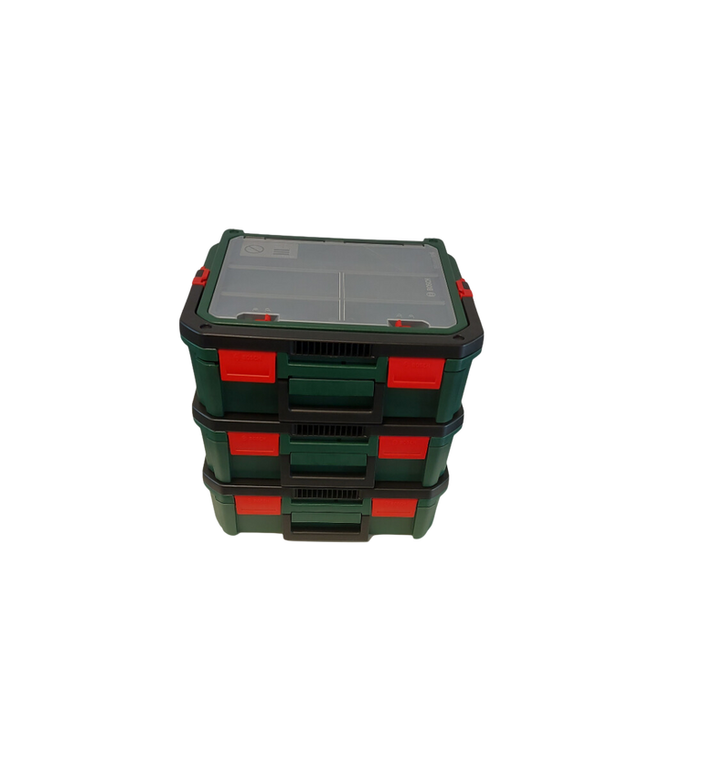
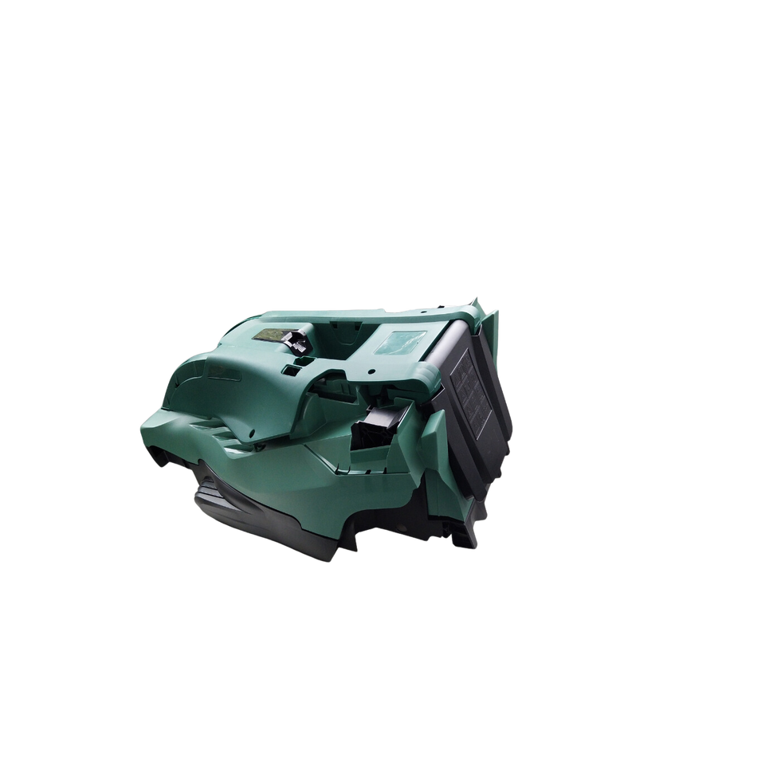


Key Products
As part of this partnership, Flair Plastic Ltd. manufactures several critical components, including:
Lawnmower Housings: Robust and lightweight plastic housings that enhance the durability and performance of high-efficiency lawnmowers.
Tool Storage Systems: Custom-designed plastic storage solutions that ensure tools are organized and easily accessible.
Paint Spray System Components: Precision parts for advanced paint spray systems, vital for consistent application and professional finishes.
Sanding Tool Housings: Ergonomically designed housings for palm sanders, providing comfort and precision for detailed work.

Slide 3
Partnership Benefits
Geographical Proximity: The close EU locations of our facilities streamline logistics, reduce lead times, and lower transportation costs.
01
This collaboration offers numerous benefits:
Quality Control: Rigorous quality assurance processes ensure all products consistently meet the highest standards.
02
Comprehensive Manufacturing: Our advanced machinery supports the efficient production of both large and small components, allowing us to meet a variety of needs.
03
Sustainability Focus: Both companies prioritize sustainability, using recycled materials wherever possible while maintaining product quality.
04

Slide 4

Challenges
Throughout the partnership, we have navigated several challenges:
Order Volume Variability: Fluctuations in order sizes driven by seasonal demand and market trends.
Material Quality Consistency: Ensuring consistent quality when working with recycled materials, which can vary in composition.
Packaging Costs: Balancing the need for sustainable packaging with the associated costs.

Slide 5
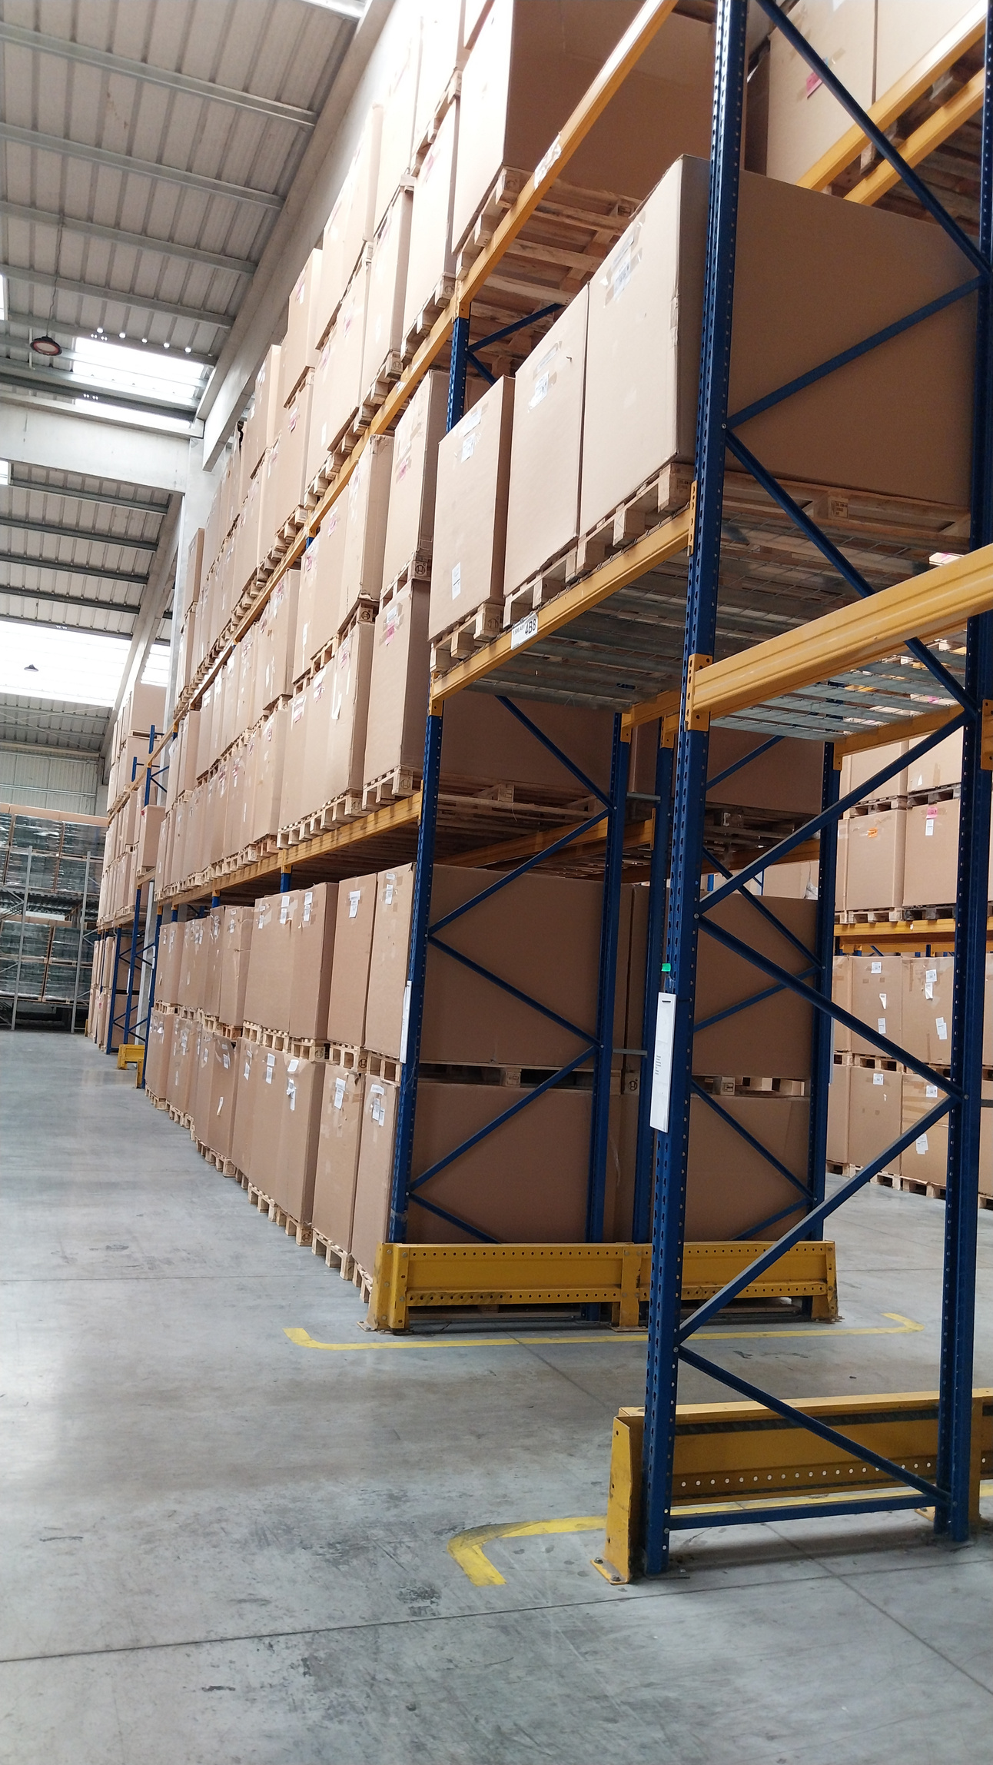

Solutions and Lessons Learned
To address these challenges, we implemented:
Adaptive Order Management: A flexible order management system that allows quick adjustments to production schedules, ensuring responsiveness to demand changes.
Enhanced Quality Control: Intensified inspections of incoming recycled materials to maintain consistent quality across all products.
Sustainable Packaging Solutions: Optimized packaging designs and sourced eco-friendly materials to reduce costs while supporting environmental goals.

Slide 6


Looking ahead, Flair Plastic Ltd. and our EU partner are committed to ongoing innovation. We will continue exploring new materials and manufacturing techniques to further improve product quality and efficiency, ensuring we remain leaders in the garden and power tools industry.

Slide 7
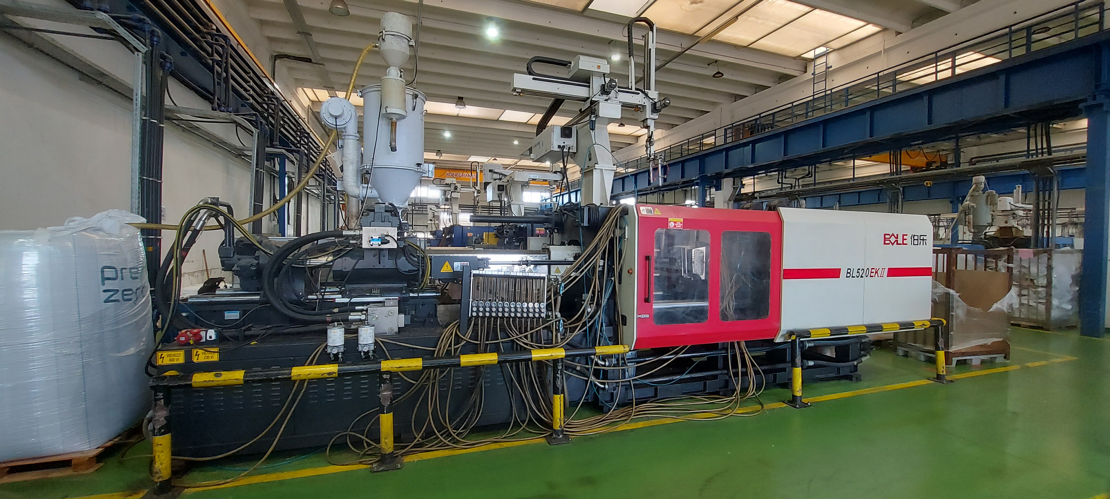

Competitive Advantage
Our partnership’s success is built on Flair Plastic Ltd.’s strategic location, advanced manufacturing capabilities, and unwavering commitment to quality and sustainability. These factors enable us to consistently deliver high-quality products that meet the evolving needs of the market.

Slide 8
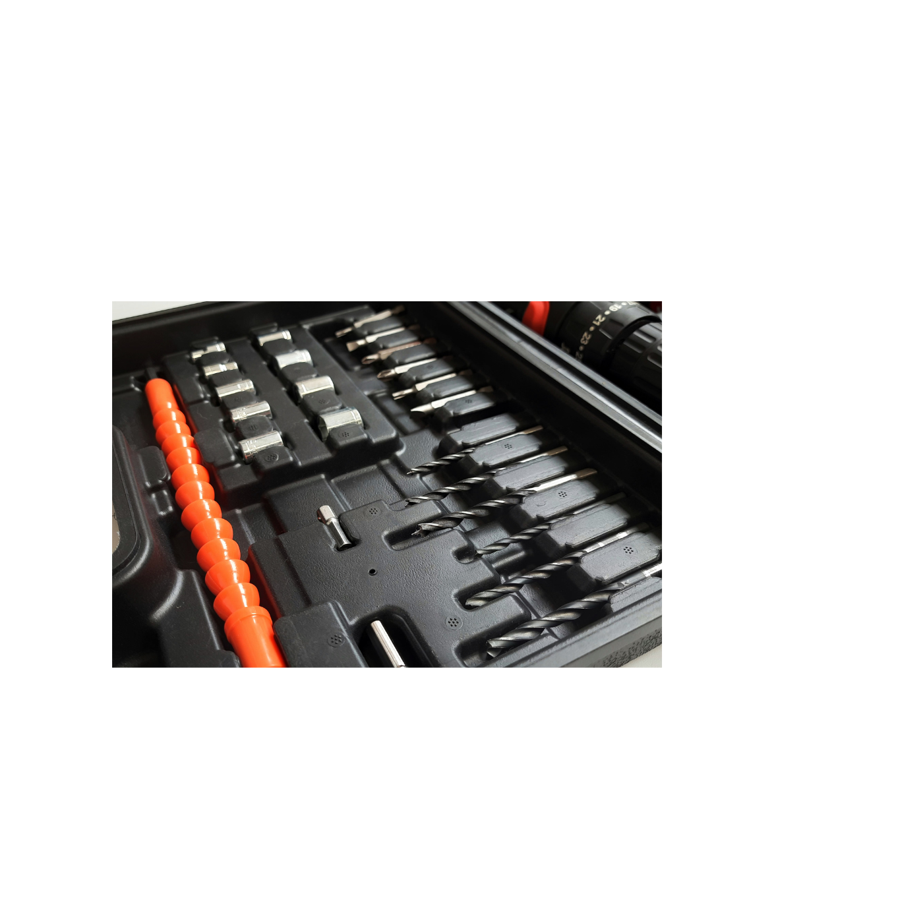
Conclusion
The decade-long collaboration between Flair Plastic Ltd. and our European partner has been a model of success, driving innovation and ensuring sustained growth for both companies. Together, we have consistently delivered products that exceed market expectations and position us strongly for the future

